Slide 1

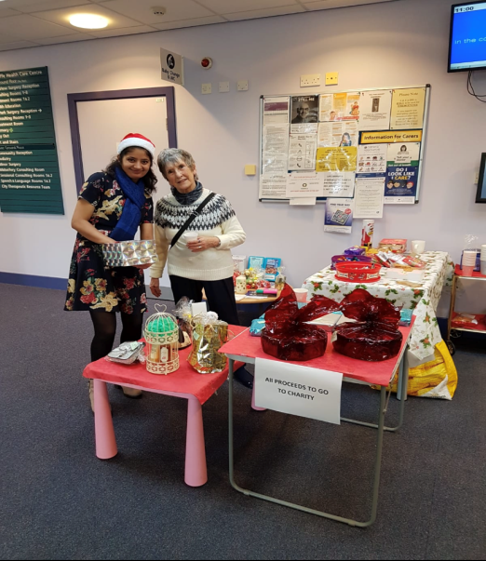
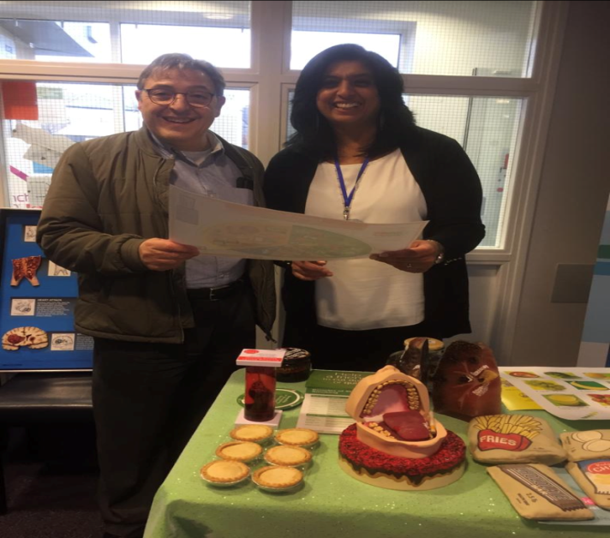

December 2019
We held a smoking cessation stall for the patients and had lots of interest!
We were looking at the consequences of obesity, weight of fat, the effects of smoking on the teeth and lungs and how much tar cigarettes contain!
Thursday 19th December was our annual Christmas Fayre!
With help from staff and our Patient Participation Group and we had a lovely morning.
We had lots of food, a tombola, how many baubles are in the jar? And lots of laughs!!
Thank you to everybody who donated and bought raffle tickets!
We raised £56.21p in total for charity!!

